Slide 1
Systems of Linear Equations in Three Variables

Slide 2
Systems of Linear Equations
in Three Variables

Slide 3
Systems of Linear Equations in Three Variables
An equation of the form Ax + By + Cz = D, with A, B, and C not all zero, is a linear equation in three variables. A solution of an equation in three variables is an ordered triple (x, y, z).
The ordered triple (2, –1, –3) is one of the solutions of the equation 2x – 3y + z = 4. The ordered triple (3, 1, 1) is another solution. In fact, an infinite number of ordered triples are solutions of the equation.
Graphing an equation in three variables requires a third coordinate axis perpendicular to the xy-plane. This third axis is commonly called the z-axis.

Slide 4
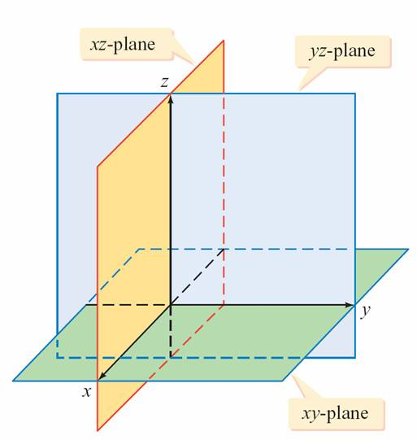
Systems of Linear Equations in Three Variables
The result is a three dimensional coordinate system called the xyz-coordinate system (See Figure 9.9).
Figure 9.9

Slide 5
Systems of Linear Equations in Three Variables
To visualize a three-dimensional coordinate system, think
of a corner of a room: the floor is the xy-plane, one wall is
the yz-plane, and the other wall is the xz-plane.
Graphing an ordered triple requires three moves: the first
along the x-axis, the second along the y-axis, and the third
along the z-axis.

Slide 6
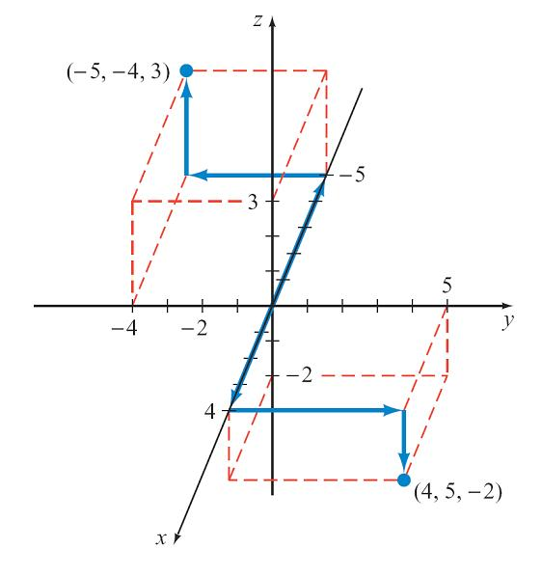
Systems of Linear Equations in Three Variables
Figure 9.10 is the graph of the points (–5, – 4, 3) and
(4, 5, –2).
Figure 9.10

Slide 7
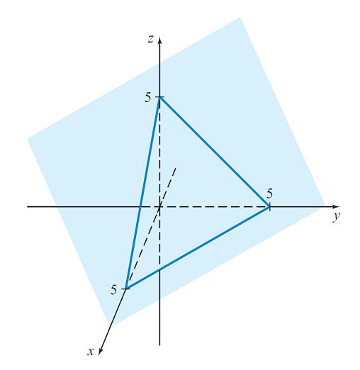
Systems of Linear Equations in Three Variables
The graph of a linear equation in three variables is a plane.
That is, if all the solutions of a linear equation in three variables were plotted in an xyz-coordinate system, the
graph would look like a large, flat
piece of paper with infinite extent.
Figure 9.11 is a portion of the
graph of x + y + z = 5.
Figure 9.11

Slide 8
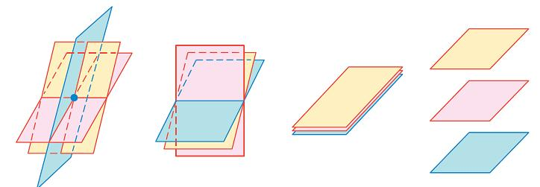
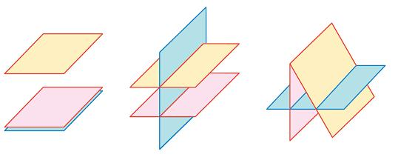
Systems of Linear Equations in Three Variables
There are different ways in which three planes can be oriented in an xyz-coordinate system. Figure 9.12 illustrates several ways.
For a system of linear equations in three variables to have a solution, the graphs of the equations must be three planes that intersect at a point, be three planes that intersect along a common line, or all be the same plane.
a.
b.
c.
d.
e.
f.
g.
Figure 9.12

Slide 9
Systems of Linear Equations in Three Variables
In Figure 9.12, the graphs in a., b., and c. represent
systems of equations that have a solution.
The system of equations represented in Figure 9.12a is a
consistent system of equations. Figure 9.12b and
Figure 9.12c are graphs of dependent systems of
equations.
The remaining graphs are the graphs of inconsistent
systems of equations.

Slide 10

Systems of Linear Equations in Three Variables
A system of equations in more than two variables can be solved by using the substitution method or the elimination method. To illustrate the substitution method, consider the system of equations
x – 2y + z = 7 (1)
2x + y – z = 0 (2)
3x + 2y – 2z = –2 (3)
Solve Equation (1) for x and substitute the result into Equation (2) and Equation (3).
x = 2y – z + 7 (4)

Slide 11
Systems of Linear Equations in Three Variables
2(2y – z + 7) + y – z = 0
4y – 2z + 14 + y – z = 0
5y – 3z = –14 (5)
3(2y – z + 7) + 2y – 2z = –2
6y – 3z + 21 + 2y – 2z = –2
8y – 5z = –23 (6)
Substitute 2y – z + 7 for x
in Equation (2).
Simplify.
Substitute 2y – z + 7 for x
in Equation (3).
Simplify.

Slide 12


Systems of Linear Equations in Three Variables
Now solve the system of equations formed from Equations (5) and (6).
Substitute 3 for z into Equation (5) and solve for y.
5y – 3z = –14
5y – 3(3) = –14
5y – 9 = –14
5y = –5
5y – 3z = –14
Multiply by 8.
40y – 24z = –112
8y – 5z = –23
Multiply by –5.
– 40y + 25z = 115
z = 3
Equation (5)

Slide 13
Systems of Linear Equations in Three Variables
y = –1
Substitute –1 for y and 3 for z into Equation (4) and solve for x.
x = 2y – z + 7
= 2(–1) – (3) + 7
= 2
The ordered-triple solution is (2, –1, 3). The graphs of the three planes intersect at a single point.

Slide 14
Triangular Form

Slide 15
Triangular Form
There are many approaches we can take to determine the solution of a system of equations by the elimination method.
For consistency, we will generally follow a plan that produces an equivalent system of equations in triangular form. Three examples of systems of equations in triangular form are
2x – 3y + z = – 4
2y + 3z = 9
–2z = –2

Slide 16
Triangular Form
w + 3x – 2y + 3z = 0
2x – y + 4z = 8
–3y – 2z = –1
3z = 9
3x – 4y + z = 1
3y + 2z = 3

Slide 17
Triangular Form
Once a system of equations is written in triangular form, the
solution can be found by back substitution—that is, by
solving the last equation of the system and substituting
back into the previous equation.
This process is continued until the value of each variable
has been found.

Slide 18
Triangular Form
As an example of solving a system of equations by back substitution, consider the following system of equations in triangular form.
2x – 4y + z = –3 (1)
3y – 2z = 9 (2)
3z = –9 (3)
Solve Equation (3) for z. Substitute the value of z into Equation (2) and solve for y.
3z = –9
z = –3
Equation (3)

Slide 19
Triangular Form
3y – 2z = 9
3y – 2(–3) = 9
3y = 3
y = 1
Replace z with –3 and y with 1 in Equation (1) and then solve for x.
2x – 4y + z = –3
2x – 4(1) + (–3) = –3
2x – 7 = –3
Equation (2)
z = –3
Equation (1)

Slide 20
Triangular Form
x = 2
The solution is the ordered triple (2, 1, –3).

Slide 21
Example 1 – Solve an Independent System of Equations
x + 2y – z = 1 (1)
Solve: 2x – y + z = 6 (2)
2x – y – z = 0 (3)
Solution:
Eliminate x from Equation (2) by multiplying Equation (1) by
–2 and then adding it to Equation (2). Replace Equation (2) with the new equation.
–2x – 4y + 2z = –2
2x – y + z = 6
–5y + 3z = 4
–2 times Equation (1)
Equation (2)
Add the equations.

Slide 22
Example 1 – Solution
cont’d
x + 2y – z = 1 (1)
–5y + 3z = 4 (4)
2x – y – z = 0 (3)
Eliminate x from Equation (3) by multiplying Equation (1) by –2 and adding it to Equation (3). Replace Equation (3) with the new equation.
–2x – 4y + 2z = –2
2x – y – z = 0
–5y + z = –2
Replace Equation (2).
–2 times Equation (1)
Equation (3)
Add the equations.

Slide 23
Example 1 – Solution
cont’d
x + 2y – z = 1 (1)
–5y + 3z = 4 (4)
–5y + z = –2 (5)
Eliminate y from Equation (5) by multiplying Equation (4) by –1 and then adding it to Equation (5). Replace Equation (5) with the new equation.
5y – 3z = – 4
–5y + z = –2
–2z = – 6
Replace Equation (3).
–1 times Equation (1)
Equation (5)
Add the equations.

Slide 24
Example 1 – Solution
cont’d
x + 2y – z = 1 (1)
–5y + 3z = 4 (4)
–2z = – 6 (6)
The system of equations is now in triangular form. Solve the system of equations by back substitution.
Solve Equation (6) for z. Substitute the value into Equation (4), and then solve for y.
–2z = – 6
z = 3
Replace Equation (5).
Equation (6)

Slide 25
Example 1 – Solution
cont’d
–5y + 3z = 4
–5y + 3(3) = 4
–5y = –5
y = 1
Replace z with 3 and y with 1 in Equation (1), and then solve for x.
x + 2y – z = 1
x + 2(1) – 3 = 1
x = 2
Equation (4)
Replace z with 3.
Solve for y.
Equation (1)
Replace y with 1; replace z with 3.

Slide 26
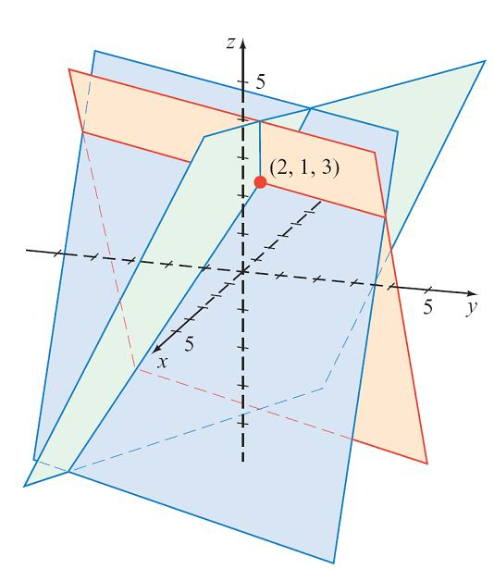
Example 1 – Solution
cont’d
The system of equations is consistent. The solution is the ordered triple (2, 1, 3). See Figure 9.13.
Figure 9.13

Slide 27
Nonsquare Systems of Equations

Slide 28
Nonsquare Systems of Equations
The systems of linear equations we have solved so far
contain the same number of variables as equations. These
are square systems of equations.
If there are fewer equations than variables—a nonsquare
system of equations—the system has either no solution or
an infinite number of solutions.

Slide 29
Example 4 – Solve a Nonsquare System of Equations
x – 2y + 2z = 3 (1)
2x – y – 2z = 15 (2)
Solution:
Eliminate x from Equation (2) by multiplying Equation (1) by –2 and adding it to Equation (2). Replace Equation (2).
x – 2y + 2z = 3 (1)
3y – 6z = 9 (3)
Solve Equation (3) for y.
3y – 6z = 9
Solve:

Slide 30
Example 4 – Solution
cont’d
y = 2z + 3
Substitute 2z + 3 for y in Equation (1) and solve for x.
x – 2y + 2z = 3
x – 2(2z + 3) + 2z = 3
x = 2z + 9
For each value of z selected, there are corresponding values for x and y. If z is any real number c, then the solutions of the system are the ordered triples
(2c + 9, 2c + 3, c).
y = 2z + 3

Slide 31
Homogeneous Systems of Equations

Slide 32
Homogeneous Systems of Equations
A system of linear equations in which the constant term is zero for all equations is called a homogeneous system of equations.
Two examples of homogeneous systems of equations are
2x – 3y + 5z = 0
3x + 4y = 0
3x + 2y + z = 0
2x + 3y = 0
x – 4y + 5z = 0

Slide 33
Homogeneous Systems of Equations
The ordered pair (0, 0) is always a solution of a
homogeneous system of equations in two variables, and the ordered triple (0, 0, 0) is always a solution of a homogeneous system of equations in three variables. This solution is called the trivial solution.
Sometimes a homogeneous system of equations may have
solutions other than the trivial solution. For example,
(1, –1, –1) is a solution of the homogeneous system of
three equations in three variables given above.

Slide 34
Homogeneous Systems of Equations
If a homogeneous system of equations has a unique
solution, the graphs intersect only at the origin.
Solutions of a homogeneous system of equations can be
found by using the substitution method or the elimination
method.

Slide 35
Example 5 – Solve a Homogeneous System of Equations
x + 2y – 3z = 0 (1)
Solve: 2x – y + z = 0 (2)
3x + y – 2z = 0 (3)
Solution:
Eliminate x from Equations (2) and (3) and replace these equations with the new equations.
x + 2y – 3z = 0 (1)
–5y + 7z = 0 (4)
–5y + 7z = 0 (5)

Slide 36
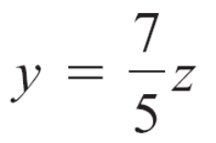
Example 5 – Solution
cont’d
Eliminate y from Equation (5). Replace Equation (5).
x + 2y – 3z = 0 (1)
–5y + 7z = 0 (4)
0 = 0 (6)
Because Equation (6) is an identity, the solutions of the system are the solutions of Equations (1) and (4).
Solve Equation (4) for y.

Slide 37

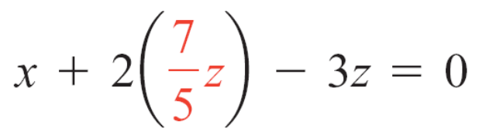
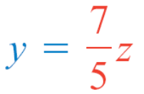
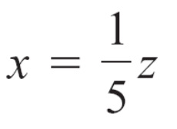
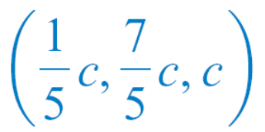
Example 5 – Solution
cont’d
Substitute the expression for y into Equation (1) and solve for x.
Letting z be any real number c, we find that the solutions of the system are the ordered triples
Equation (1)

Slide 38
Applications of Systems
of Equations

Slide 39
Applications of Systems of Equations
One application of a system of equations is curve fitting.
Given a set of points in the plane, we can try to find an
equation whose graph passes through, or fits, all of the
points.

Slide 40

Example 6 – Solve an Application of a System of Equations to Curve Fitting
Find an equation of the form y = ax² + bx + c whose graph passes through the points located at (1, 4), (–1, 6), and
(2, 9).
Solution:
Substitute each of the given ordered pairs into the equation
y = ax² + bx + c.
Write the resulting system of equations.
4 = a(1)² + b(1) + c or a + b + c = 4 (1)
6 = a(–1)² + b(–1) + c or a – b + c = 6 (2)
9 = a(2)² + b(2) + c or 4a + 2b + c = 9 (3)

Slide 41
Example 6 – Solution
cont’d
Solve the resulting system of equations for a, b, and c.
Eliminate a from Equation (2) by multiplying Equation (1) by –1 and then adding it to Equation (2).
Now eliminate a from Equation (3) by multiplying
Equation (1) by – 4 and adding it to Equation (3).
The result is
a + b + c = 4
–2b = 2
–2b – 3c = –7

Slide 42
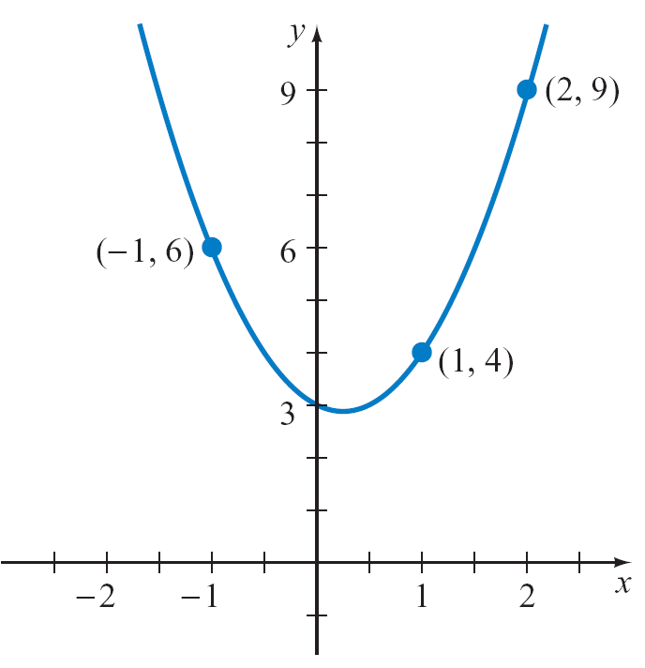
Example 6 – Solution
cont’d
Although this system of equations is not in triangular form, we can solve the second equation for b and use this value to find a and c.
Solving by substitution, we obtain a = 2, b = –1, and c = 3.
The equation of the form
y = ax² + bx + c whose graph
passes through (1, 4), (–1, 6),
and (2, 9) is y = 2x² – x + 3.
See Figure 9.16.
y = 2x² – x + 3
Figure 9.16

